Slide 1
Counseling, Testing, and Accessibility at UA
Sara Rieder Bennett, Ph.D.
Director of Testing, Psychologist www.uakron.edu/testing
Notes:
Includes Counseling and Testing Services in Simmons, Computer Based Assessment and Evaluation in Schrank Hall, and we work closely with our colleagues in the Office of Accessibility in Simmons Hall. We’ll provide an overview of each service here at UA and how to access them.

Slide 2
Myth or Fact?
  Going to counseling means something is really wrong with me.
  Myth – most people in counseling just need support through a difficult time.
  Everyone will know if I go to counseling.
  Myth – counseling is confidential.
  Nearly half of Americans have attended counseling.
  Fact – more than 4 in 10 Americans report having seen a counselor.
Going to counseling is no different than talking to a friend or family member.
Myth - counselors are professionals trained to maintain boundaries, and provide interventions focused on your goals and need.
Counseling has stronger research support than medication.
Fact – counseling is based on decades of intensive study showing better outcomes than any medications.
Notes:
While some people in counseling struggle with serious mental illness, most people are working through everyday problems like relationships issues, grief, transitions (like to college), career decision making, or just needing a space to work on stress management.
Psychologists and counselors are legally obligated to maintain your confidentiality – including whether you have ever been to counseling. There are rare exceptions to maintain your safety which are discussed prior to starting counseling, and you will always be included in these discussions. The counseling center cannot even share with other staff that you have come in, without your legal consent.
42% and rising – starting with gen X, we are seeing increasing willingness to go to counseling and be open about seeking support.
If you have a headache or body ache, what might you do? (I have ibuprofen in multiple places like work and home) So, when I say ANY medication – I mean that research shows higher effectiveness of counseling to address mental health than painkillers like ibuprofen for reducing headaches. But most of us would turn to medication without even questioning whether it is helpful.

Slide 3
Who are the Counselors?
A team of diverse staff members including Licensed Psychologists, Psychology Pre-Doctoral Interns, and Doctoral Practicum Psychology Trainees
We provide comprehensive culturally-responsive psychological counseling and testing services
Meet the Staff: www.uakron.edu/counseling/staff

Slide 4
Counseling Services
Open to all University of Akron students
Group, individual, career, and educational counseling – in-person and virtual available (must be in Ohio)
Learning Disability/ADHD/Autism testing, psychological testing
Workshops and Outreach
Accredited by IACS (International Accreditation of Counseling Services), Internship accredited by APA (American Psychological Association)
FREE AND CONFIDENTIAL
Notes:
Counseling for a variety of needs such as depression, anxiety, stress, relationships problems, academic concerns, and career planning
Groups were designed based on the number of students reporting a need – including relationship/interpersonal support group, anxiety and depression management (Anxiety Management Group, Feel Better Fast).

Slide 5

When to seek counseling services
Anxiety/depression
  Up to 70% of students may experience anxiety and/or depression at some point during their degree
Academic distress
  Don't wait until you are really struggling!
Relationship distress
Stress management
  Transitions and balancing roles are always challenging

Slide 6

School is a marathon – not a sprint!
Connect with and help others
Breathe and relax
Focus on the big picture
Be kind to yourself!
Nutrition, sleep, and exercise
Laugh, play, and spend time with loved ones

Slide 7

How to seek counseling services
Located in Simmons Hall 306
Monday – Friday 8 am to 5 pm
Call us at 330-972-7082 to learn more
Intakes are walk-ins, same day
www.uakron.edu/counseling

Slide 8
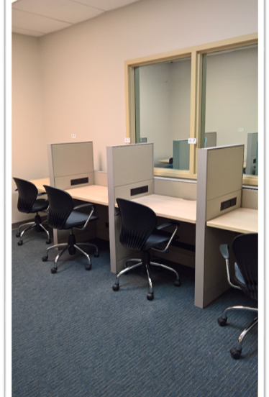
University of Akron
Testing Centers
Counseling & Testing Center (CTC)
15 computer seats, 16 accessible paper seats
Proctor wide range of exams including accommodated course testing, make-up testing, national standardized testing programs, certification/licensure, psychological assessments
Director: Sara Rieder Bennett
Testing Specialist: Meghan Redle, Sarah Weaver
Graduate and undergraduate test proctors
Notes:
Three testing locations on Main campus (also regional campuses have testing locations)
Exam proctoring for UA students – make-up testing, accommodated exams*, limited group paper-based testing. Proctor sheets required for all on-campus exams.
Proctoring exams for students of other institutions (e.g. online, distance learning)
Residual ACT – admissions test for UA applicants only
National testing programs (admissions, licensure) – ACT, SAT, LSAT, MPRE, GRE-Subject, MAT
Certification and licensure exams through test vendor partners
Foreign language placement testing
Prior learning assessments – e.g. CLEP

Slide 9
CTC – Testing Services Mission
Testing Services adheres to the mission of the Counseling & Testing Center and promotes community engagement and student learning, success, and retention by providing a standardized testing environment for University and community members. The Testing Services differentiates itself and the University by its certification through the National College Testing Association (NCTA) and adheres to the NCTA Professional Standards and Guidelines.
Member of NCTA, Great Lakes College Testing Association, and NCTA Proctoring Network

Slide 10
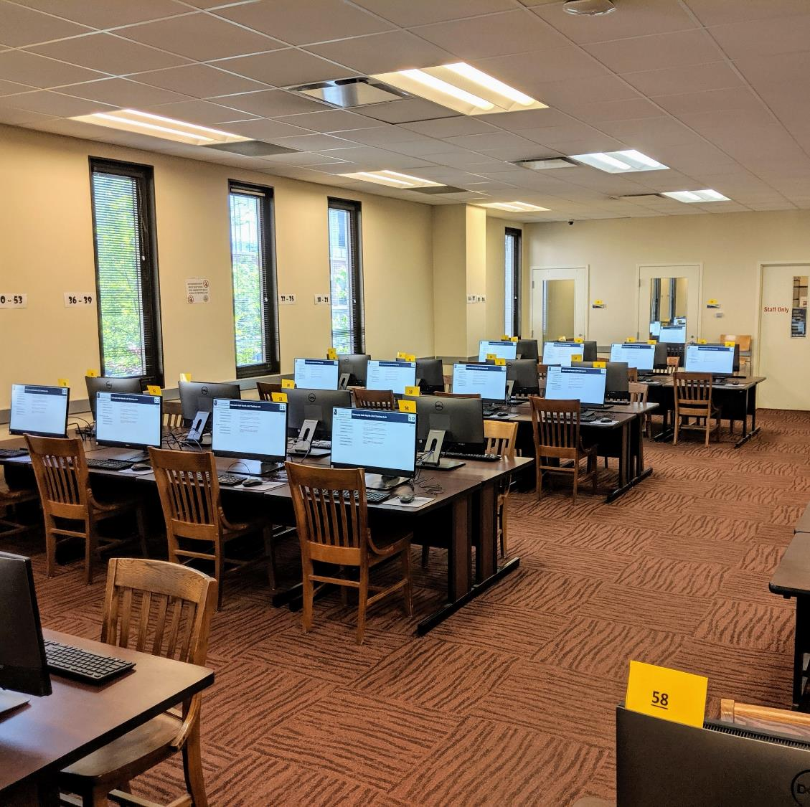
University of Akron Testing Centers
Computer Based Testing
82 computer seats in main lab with 2 distraction-reduced computer testing rooms
Proctor course testing (LMS) and placement testing for incoming UA students
Report through CTC in Student Affairs
CBT Manager: Josh Rivas,
Staff: Todd Christenson, Sarah Weaver (part-time in both locations), Student Monitors

Slide 11
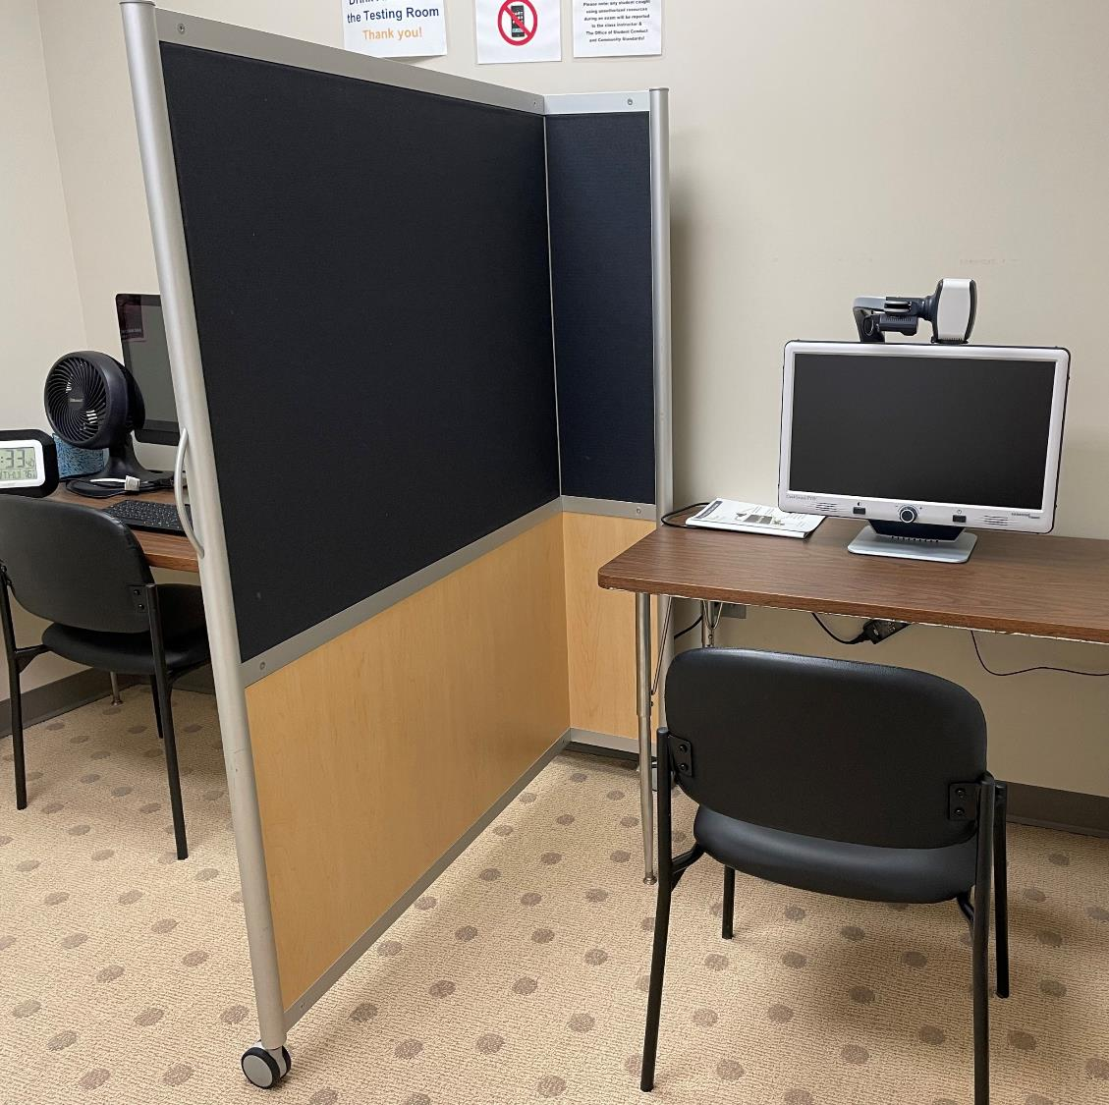
University of Akron
Testing Centers
Office of Accessibility
4 testing rooms, 7 total testing seats with overflow space available
Proctor course testing for students with accommodations like: reader, scribe, and adaptive technology, as well as those who may need a private room.
Report to Executive Director in CTC under Student Affairs
Director: Jessica DeFago
Office Manager: Rachael Kosar
Disability specialists, service coordinators, and student staff
Notes:
Mission to provide students with full access to the academic environment; advocate for social justice for students with disabilities; embrace the diversity of our student body; celebrate a culturally sensitive and accessible campus
Provide a range of services for students with disabilities, including temporary medical supports
Students can register online through www.uakron.edu/access

Slide 12

Testing Services
Counseling & Testing Center, Simmons Hall 304, 330-972-7084
www.uakron.edu/counseling/testing
For placement testing for incoming students, see www.uakron.edu/placement. New students have received an email indicating any required placement testing prior to Orientation.
For general campus-wide testing information, see www.uakron.edu/testing

Slide 13
The University of Akron
Office of Accessibility

Slide 15
Register with the OA
It’s easy as 1-2-3
1. Application
Complete the online application at www.uakron.edu/access.
2. Documentation
Submit current documentation from a qualified treatment professional. Guidelines are available at www.uakron.edu/access/forms.
3. Appointment
Make an appointment to meet with a Disability Specialist to determine reasonable accommodations once required documentation is received.
Notes:
Smart link to click on

Slide 16
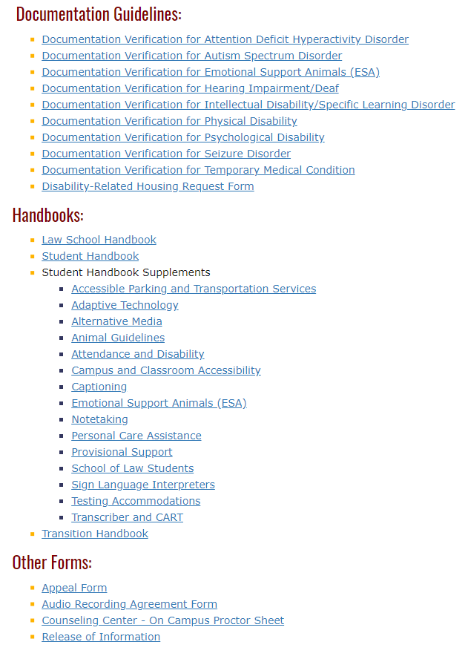
Documentation Guidelines
https://www.uakron.edu/access/forms/
TIPS:
Use OA's Documentation Guidelines
IEP is not sufficient- Include ETR!!
Have professionals link limitations to accommodation recommendations
Provide current documentation
REMEMBER: Services will look very different in college!!

Slide 17

Additional Supports
Information Sessions
Accommodations for Placement Exams
Academic Support Sessions with a Disability Specialist
RLH Accommodations
Individual disability related student appointments
Campus physical accessibility walk-throughs
Campus wide consultation
College2Careers – Opportunities for Ohioans with Disabilities
Referral Services and Bridging Connections
Educational Outreach

Slide 18

Office Of Accessibility Contact Information
Website: https://www.uakron.edu/ACCESS/
Email: access@uakron.edu
Phone Number: 330-972-7928
Physical Location: Simmons Hall, 105

Slide 19

Questions?
Sara Rieder Bennett, Ph.D.
slr45@uakron.edu

